Slide 1
Cybersecurity tools & Concepts
Weekly Learning Reflection

Slide 2

Introduction
This presentation reflects on essential cybersecurity tools and concepts. It highlights the functionalities of key tools like Nmap and Wireshark, and covers foundational frameworks such as MITRE ATT&CK. Emphasizing the importance of these tools, this learning experience aims to equip practitioners with the knowledge needed to navigate the evolving cybersecurity landscape.

Slide 3

Cybersecurity Tools
Nmap (Advanced Network Mapping)
Wireshark (Protocol Analysis & Deep Packet Inspection)
MITRE ATT&CK Framework
Google Dorking (OSINT)
Kali Tools: 🔹 Hydra 🔹 Nikto 🔹 Burp Suite

Slide 4

Nmap - Advanced Network Mapper
Purpose: Detect hosts, scan ports, fingerprint OS/services, and identify vulnerabilities.
Key Features:
TCP/UDP scanning
Host discovery
NSE scripting (vulnerability detection)
Service version & OS detection
Custom scan speeds and timeouts
Use Case:
bash
nmap -sS -sV -O --top-ports 100 -Pn 192.168.1.1

Slide 5
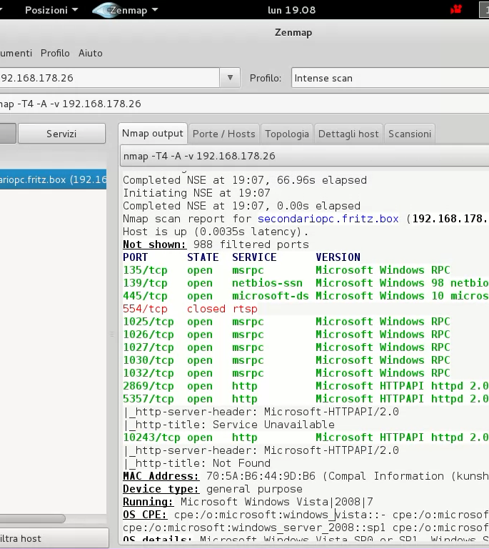
All the Commands & Flags
Target Specification
Scan Techniques
Host Discovery
Port Specification
This Photo by Unknown Author is licensed under CC BY-SA-NC

Slide 6
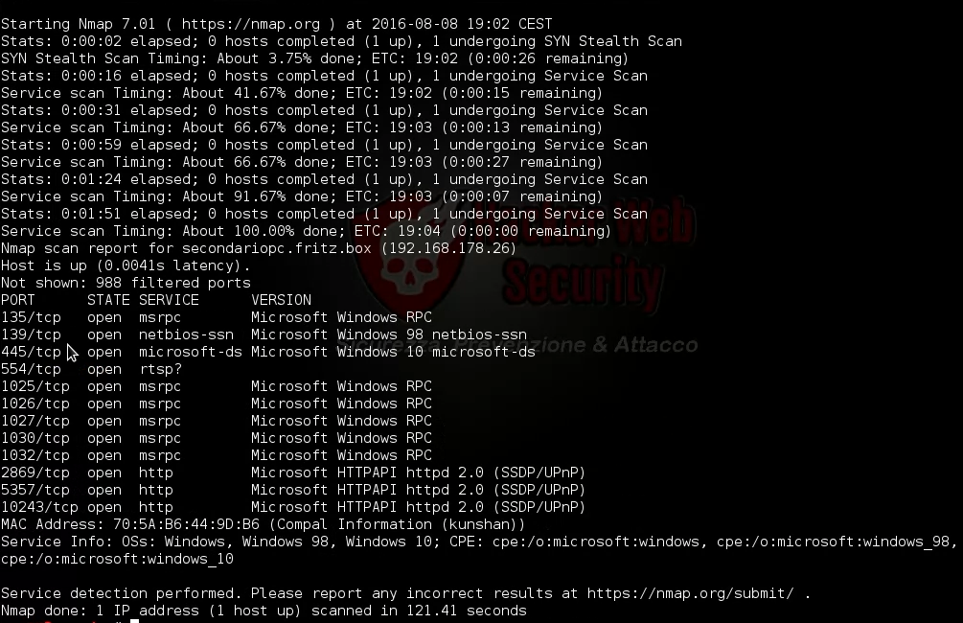
All the Commands & Flags
Service and version Detection
OS detection
Timing and performance
Timing and performance Switches
NSE Script

Slide 7

Wireshark – Protocol Analysis
Purpose: Captures network traffic and decodes protocols for detailed inspection.
Core Uses:
Real-time traffic capture
Protocol filtering (http, tls.handshake, etc.)
TLS decryption (with key logging)
Protocol hierarchy & conversations
Example: Captured and analyzed TCP handshake, DNS requests, and TLS cert chain.

Slide 8
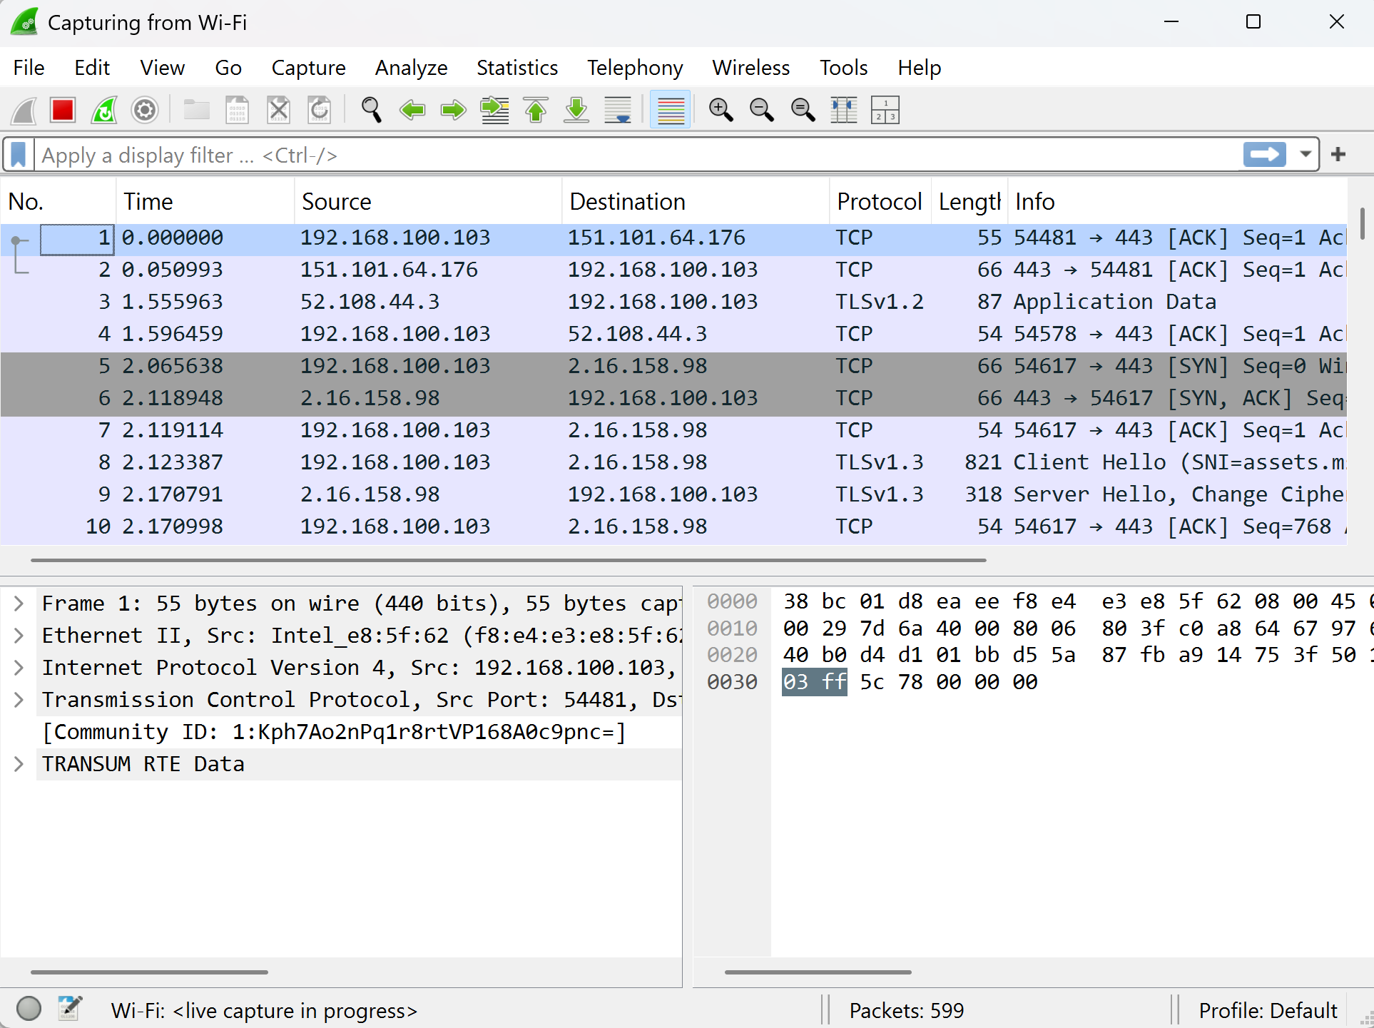
Wireshark Guide
Interface overview
Display Filters
Capture Filters
TLS/SSl Handshake

Slide 9
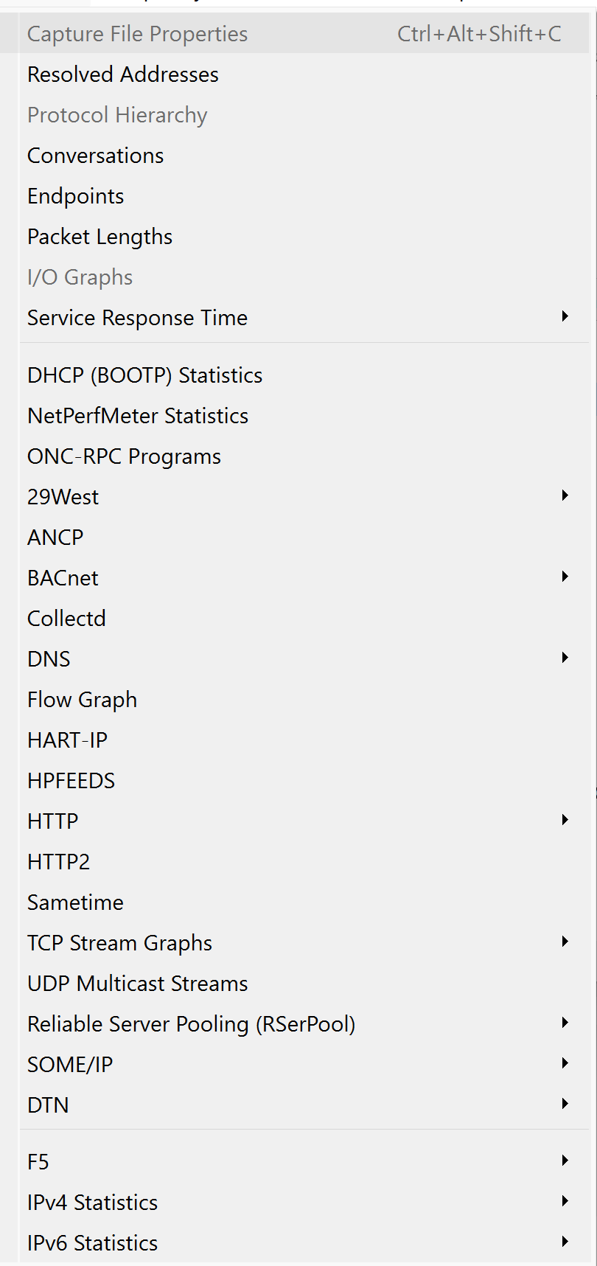
Wireshark Guide
Statistics Tools
Profile
Coloring Rules

Slide 10
Google dorks
Some important dorks that can be used
Dorks | Description
inurl:"view.shtml" "Network Camera" | Get web applications showing live webcam (online camera) footage.
site:.hk & inurl:wp-login | Get login pages of WordPress sites ending in the notoriously unsafe domain “.hk”
“”index of” inurl:ftp secret | Get FTP servers you want to access containing the keyword “secret”
"Not for Public Release" + "Confidential" ext:pdf | ext:doc | ext:xlsx | Get links to documents meant to be classified. Some come from governmental websites.

Slide 11
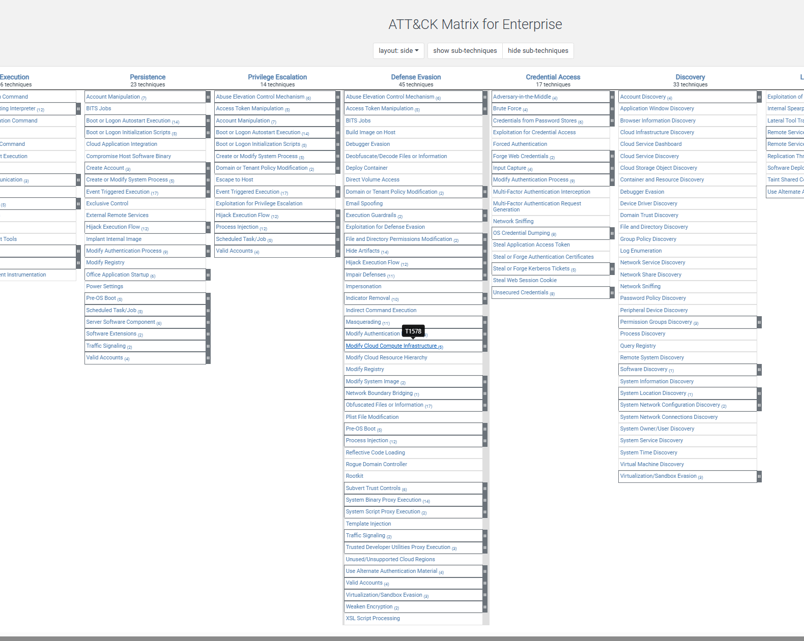
Mitre Attack Framework
What It Is: Open-source matrix mapping adversary behaviors into TTPs (Tactics, Techniques, Procedures)
Blue Team Use: Detect patterns based on known APT procedures
Red Team Use: Simulate known techniques from groups like APT28 or TeamTNT
Example Technique: T1059.001 – PowerShell T1087 – Account Discovery

Slide 12

Extra Tools
🔹 Hydra 🔹 Nikto 🔹 Burp Suite

Slide 13

Hydra
Hydra – Password Brute Force Tool Used to crack login credentials via dictionary attacks.
Supported Protocols: SSH, FTP, HTTP, RDP, SMB, Telnet, MySQL
Example Command:
bash
hydra -l admin -P rockyou.txt ssh://192.168.1.5
This Photo by Unknown Author is licensed under CC BY-NC-ND

Slide 14

Nikto
Nikto – Web Server Vulnerability Scanner Detects insecure files, outdated software, default credentials, and server misconfigs.
Features:
6700+ known vulnerabilities
Checks headers, cookies, SSL/TLS
Command Example:
bash
nikto -h http://192.168.1.100
Output: Generates a web report of potential web server weaknesses.

Slide 15
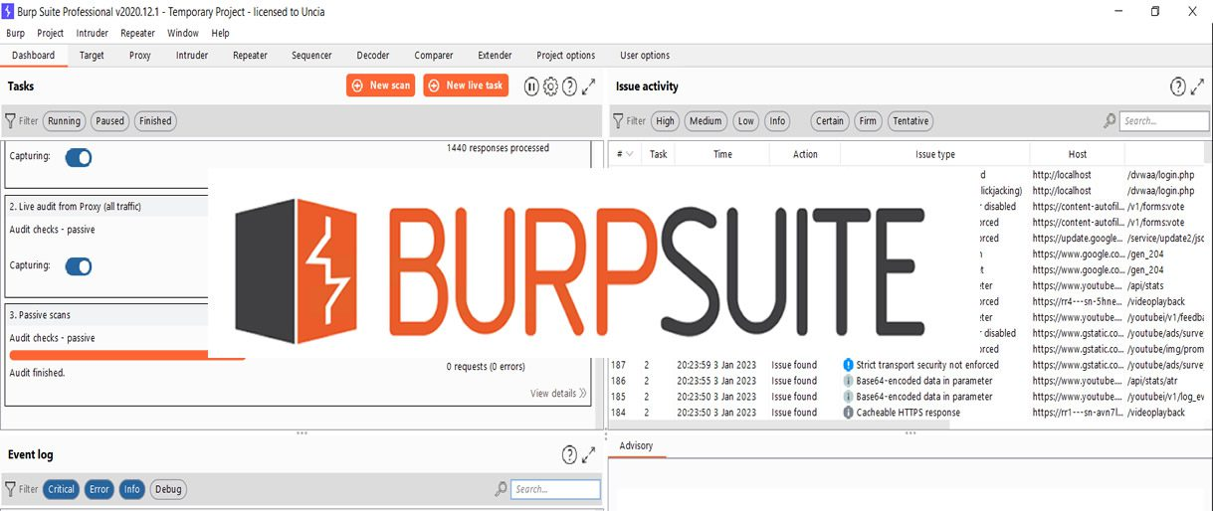
Burp suite
Burp Suite – Web Application Testing Platform
Used For:
Intercept HTTP/HTTPS requests
Modify and replay payloads
Detect vulnerabilities like XSS, SQLi
Key Modules:
Proxy (intercept traffic)
Repeater (manual payload testing)
Scanner
Intruder (automated fuzzing)
Example Workflow: Login → Intercept with Burp → Replay with modified password → Observe response

Slide 16

summary
What I Accomplished:
Practiced professional scanning and recon tools
Understood attacker mindset via MITRE
Enhanced protocol analysis with Wireshark
Simulated real-world attack surfaces with Kali tools

Slide 17

THANK YOU
By: Muhammad Naveed Ul Hassan
Institute: KaiRiz Cyber Technologies

